Slide 1
Preliminary Findings on 538s NBA Player Evaluation Model
What We Can Say About 538s Method Of Evaluating Players So Far and What to Look For In the Future
By Simrath Randhawa

Slide 2
Background
538 tries to come up with a model to capture the value of an NBA player in a given season
WAR---Wins above replacement. How many wins did player X contribute to his team in a given season
RAPTOR---The name of the model. Incorporates statistics found in NBA box scores, proprietary tracking data and compares teammates across the same team
Pace---Measures how many possessions each team has the ball in a game. Model adjusts for that in a given season
No player plays all 48 minutes in a game; how well a team performs when Player X is on the court is also tracked. Compare that to their teammates

Slide 3
Areas of Focus
Want to focus on the past 20 years---data from before not reliable
How does the model track over time
Does regular season performance predict playoff performance
Has there been any change in league wide trend across all players on how the model measures players impact on defense and offense over the past 20 years
Which components are most important in determining the overall RAPTOR number for each player

Slide 4
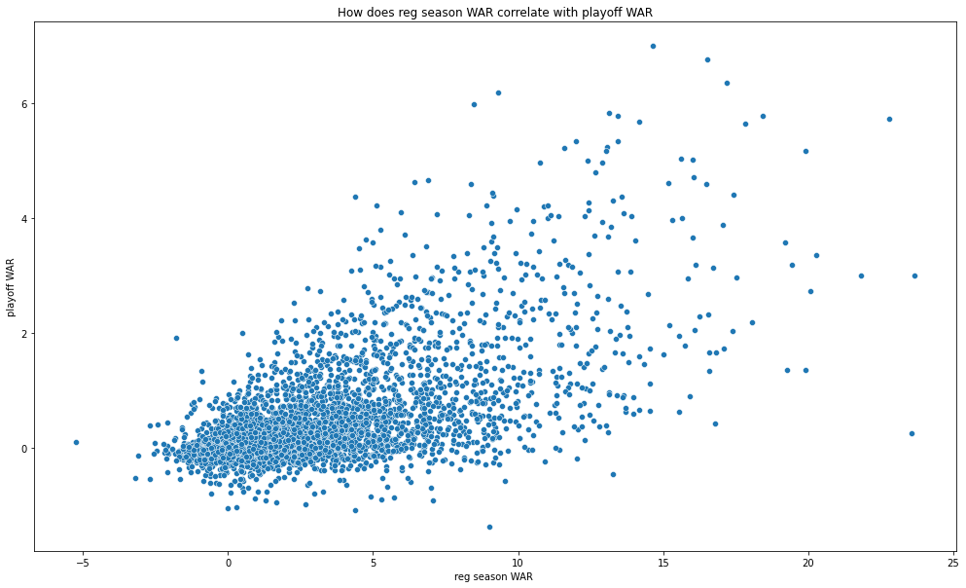
Random Forest and KNN Model: How Does Reg Season Performance Predict Playoff Performance
Identify target vector and features matrix X = df.loc[:, ['mp', 'poss', 'raptor_offense', 'raptor_defense', 'raptor_total', 'war_total', 'war_reg_season']] y = df['war_playoffs’]
Results:
Random forest: RF Training R2: 0.9924500300512565 RF Testing R2: 0.9473516518323757
KNN Training R2: 0.8391521806229068 KNN Testing R2: 0.7569308870398467
We will use random forest as the model to put into practice.

Slide 5
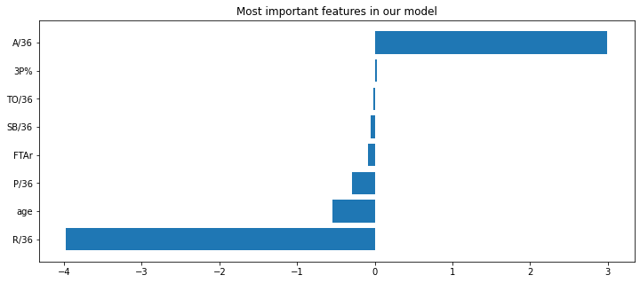
Can we predict what position a player is based off statistical characteristics
Often much debate what players positions truly are.
Debate about how we classify positions and if it is meaningful.
So worth thinking about do certain positions have specific traits based on our current definitions of them? Can they help with player classification?
Logistic regression: Test accuracy: 0.6585163696643183

Slide 6
How does Regular Season Performance Correlate with Playoff Performance
R squared value of 0.62. So there is a fair bit of correlation
Playoffs are considered higher stakes high level performance is more valued in such situations
How much players values change in regular season vs playoffs is a hot topic of debate
Further studies needed to see the relationship between the two and to what degree regular season performance can predict playoffs

Slide 7
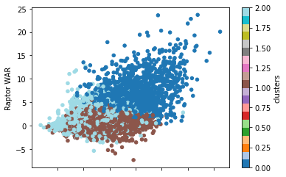
How do players who rate well or poorly in traditional metrics fair using 538s models
Did a K Clustering Model incorporating following factors:
X = df1.loc[:, ['SB/36', 'P/36', 'Raptor O', 'Raptor D', 'Raptor WAR', 'Pace +/-', 'pos’]]
Cluster below specifically is of players points per 36 min and RAPTOR rating

Slide 8
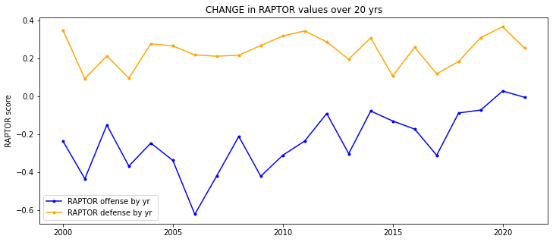
Initial findings
On average the metric has not shown much change in how much value a player adds on defense over the past 20 years.
However the average NBA player has steadily shown to provide more offensive value over the past 20 years.
Takeaways: League has more scoring now so that is not unreasonable on the surface
Takeaways: However this means that caution must be used in comparing players from different time frames

Slide 9
Further Areas Of Study
Coming up with more elaborate models to try to predict playoff performance based off regular season performance. How well will those fair?
Which specific parts of 538 models are most important in determining a players final overall RAPTOR rating
Performance of players over periods of time: is their performance stable from to year or is their volatility in performance each individual season?
Do certain types of players(ie players who rate highly on defense but low on offense as one example) tend to be more value in the playoffs or regular season specifically?

